Slide 1
Functional Dependencies and Normalization for Relational Databases
Copyright © 2007 Ramez Elmasri and Shamkant B. Navathe

Slide 2
Chapter Outline
2 Functional Dependencies (FDs)
  2.1 Definition of FD
  2.2 Inference Rules for FDs
  2.3 Equivalence of Sets of FDs
  2.4 Minimal Sets of FDs
3 Normal Forms Based on Primary Keys
  3.1 Normalization of Relations
  3.2 Practical Use of Normal Forms
  3.3 Definitions of Keys and Attributes Participating in Keys
  3.4 First Normal Form
  3.5 Second Normal Form
  3.6 Third Normal Form
4 General Normal Form Definitions (For Multiple Keys)
5 BCNF (Boyce-Codd Normal Form)
Slide 10- <number>

Slide 3
Functional Dependencies
A functional dependency is a constraint between two sets of attributes from the database.
X -> Y holds if whenever two tuples have the same value for X, they must have the same value for Y
  For any two tuples t1 and t2 in any relation instance r(R): If t1[X]=t2[X], then t1[Y]=t2[Y] is true
X -> Y in R specifies a constraint on all relation instances r(R)
Written as X -> Y; can be displayed graphically on a relation schema. ( denoted by the arrow: ).
FDs are derived from the real-world constraints on the attributes
Slide 10- <number>

Slide 4
Examples of FD constraints (1)
Social security number determines employee name
  SSN -> ENAME
Project number determines project name and location
  PNUMBER -> {PNAME, PLOCATION}
Employee ssn and project number determines the hours per week that the employee works on the project
  {SSN, PNUMBER} -> HOURS
Slide 10- <number>

Slide 5

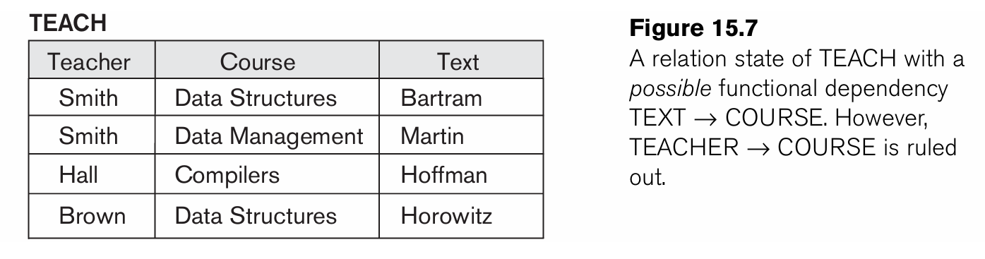
Slide 10- <number>

Slide 6
Examples of FD constraints (2)
An FD is a property of the attributes in the schema R
The constraint must hold on every relation instance r(R)
If K is a key of R, then K functionally determines all attributes in R
  (since we never have two distinct tuples with t1[K]=t2[K])
Slide 10- <number>

Slide 7
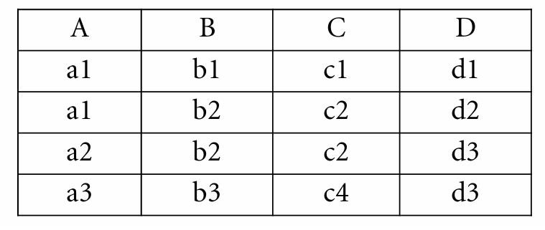
Find out all the possible FDs in the following example
Here, the following FDs may hold because the four tuples in the current extension have no violation of these constraints: B → C; C →B;{A, B} → C; {A, B} → D; and {C, D} → B. However, the following do not hold because we already have violations of them in the given extension: A → B (tuples 1 and 2 violate this constraint); B → A (tuples 2 and 3 violate this constraint); D → C (tuples 3 and 4 violate it).
Slide 10- <number>

Slide 8
2.2 Inference Rules for FDs (1)
Given a set of FDs F, we can infer additional FDs that hold whenever the FDs in F hold
Armstrong's inference rules:
  IR1. (Reflexive) If Y subset-of X, then X -> Y
  IR2. (Augmentation) If X -> Y, then XZ -> YZ
    (Notation: XZ stands for X U Z)
  IR3. (Transitive) If X -> Y and Y -> Z, then X -> Z
IR1, IR2, IR3 form a sound and complete set of inference rules
  These are rules hold and all other rules that hold can be deduced from these
Slide 10- <number>

Slide 9
Inference Rules for FDs (2)
Some additional inference rules that are useful:
  Decomposition: If X -> YZ, then X -> Y and X -> Z
  Union: If X -> Y and X -> Z, then X -> YZ
  Psuedotransitivity: If X -> Y and WY -> Z, then WX -> Z
The last three inference rules, as well as any other inference rules, can be deduced from IR1, IR2, and IR3 (completeness property)
Slide 10- <number>

Slide 10
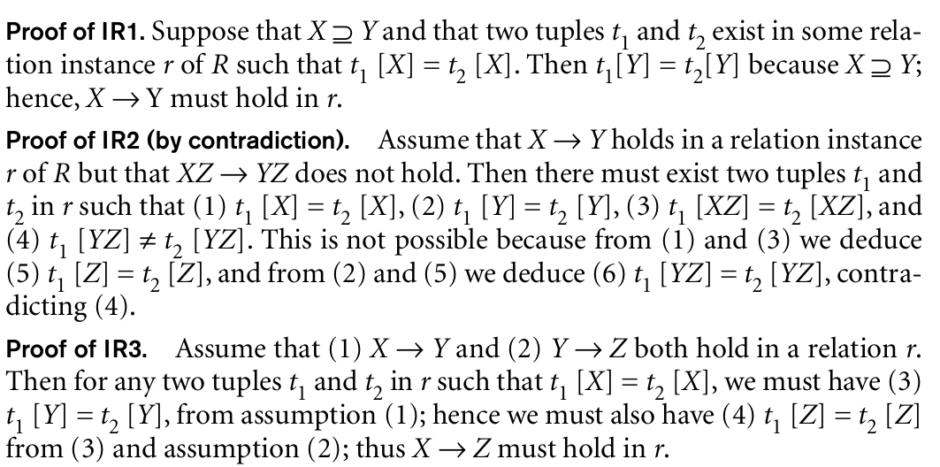
Proofs for inference Rules IR1 to IR3
Slide 10- <number>

Slide 11
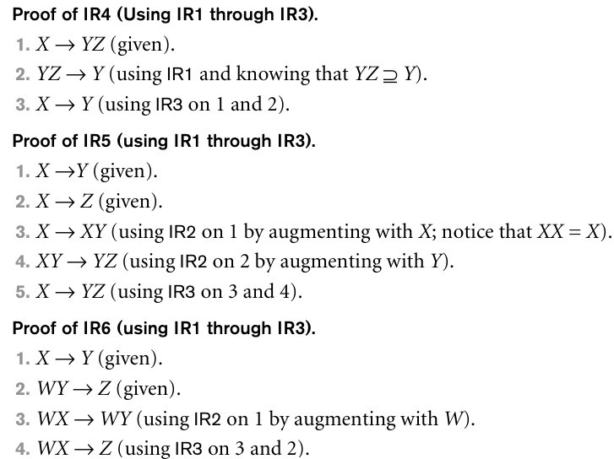
Slide 10- <number>

Slide 12
Inference Rules for FDs (3)
Closure of a set F of FDs is the set F⁺ of all FDs that can be inferred from F
Closure of a set of attributes X with respect to F is the set X⁺ of all attributes that are functionally determined by X
X⁺ can be calculated by repeatedly applying IR1, IR2, IR3 using the FDs in F
Slide 10- <number>

Slide 13
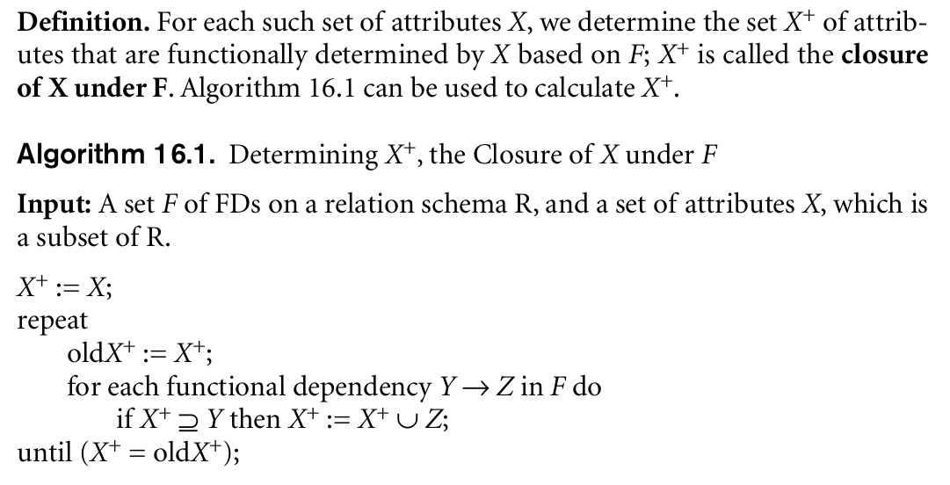
Slide 10- <number>

Slide 14
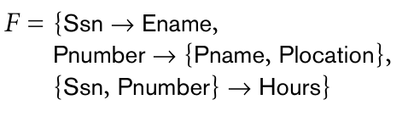
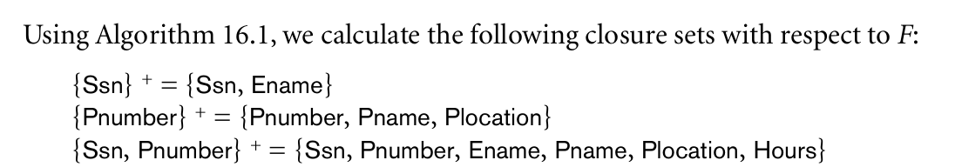
If
Then
Slide 10- <number>

Slide 15
2.3 Equivalence of Sets of FDs
Two sets of FDs F and G are equivalent if:
  Every FD in F can be inferred from G, and
  Every FD in G can be inferred from F
  Hence, F and G are equivalent if F⁺ =G⁺
Definition (Covers):
  F covers G if every FD in G can be inferred from F
    (i.e., if G⁺ subset-of F⁺)
F and G are equivalent if F covers G and G covers F
There is an algorithm for checking equivalence of sets of FDs
Slide 10- <number>

Slide 16
If all FDs of FD1 can be derived from FDs present in FD2, we can say that FD2 subset of FD1.
If all FDs of FD2 can be derived from FDs present in FD1, we can say that FD1 subset of FD2.
If 1 and 2 both are true, FD1=FD2
Slide 10- <number>

Slide 17
Check whether the following FDs are equivalent or not:
A relation R(A,B,C,D) having two FD sets FD1 = {A->B, B->C, AB->D} and FD2 = {A->B, B->C, A->C, A->D}
A relation R2(A,B,C,D) having two FD sets FD1 = {A->B, B->C,A->C} and FD2 = {A->B, B->C, A->D}
Slide 10- <number>

Slide 18
2.4 Minimal Sets of FDs (1)
A set of FDs is minimal if it satisfies the following conditions:
  Every dependency in F has a single attribute for its RHS.
  We cannot remove any dependency from F and have a set of dependencies that is equivalent to F.
  We cannot replace any dependency X -> A in F with a dependency Y -> A, where Y proper-subset-of X ( Y subset-of X) and still have a set of dependencies that is equivalent to F.
Slide 10- <number>

Slide 19
Minimal Sets of FDs (2)
Every set of FDs has an equivalent minimal set
There can be several equivalent minimal sets
There is no simple algorithm for computing a minimal set of FDs that is equivalent to a set F of FDs
To synthesize a set of relations, we assume that we start with a set of dependencies that is a minimal set
Slide 10- <number>

Slide 20
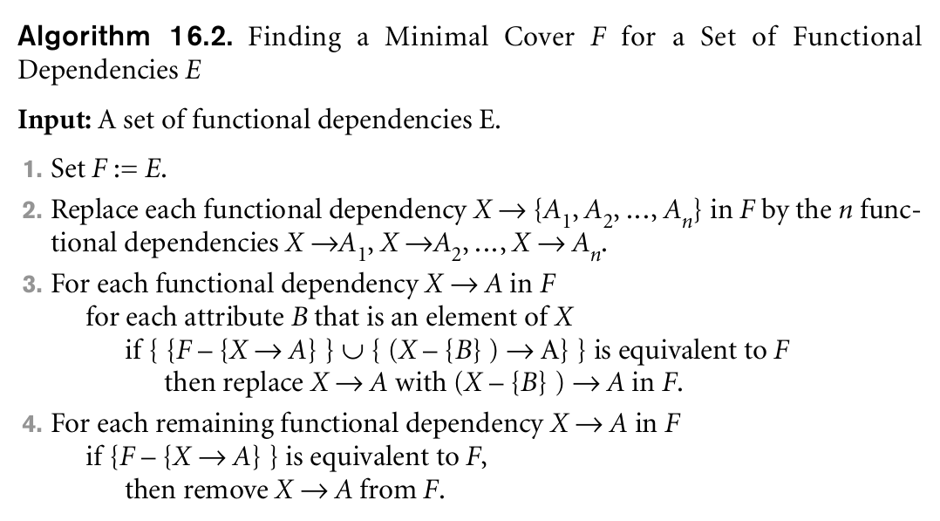
Slide 10- <number>

Slide 21
Step 1: Split the Functional Dependencies to have single attribute on the right-hand side
Step 2: Remove Redundant FDs
Step 3: Remove Extraneous Attributes on the left-hand side if you can derive the lefthand side attributes from the closure
eg: if we have an FD as AB-> E then in the last step check whether you are getting B in A+ then remove B to make the FD as A->E or if you are getting A in B+ then you can remove A to make the FD as B->E, (do not consider AB->E while deriving A+ or B+)
Slide 10- <number>

Slide 22
Exercise Problems
Find the minimal cover
E :{B → A, D → A, AB → D}
F : {A->B, B ->C, D->ABC, AC-> D}
Slide 10- <number>

Slide 23
E :{B → A, D → A, AB → D}
No decomposition possible
No redundant FDs
B+={A,B} without considering AB->D, since A is in B+, A can be removed from AB->D
So we get {B → A, D → A, B → D}.
using the transitive rule on B →D and D→A, we derive B →A. Hence B →A is redundant in E and can be eliminated.
Therefore, the minimal cover of E is {B → D,D → A}
Slide 10- <number>

Slide 24
F : {A->B, B ->C, D->ABC, AC-> D}
Applying decomposition on D->ABC, we get D->A, D->B, D->C
Using transitive property on D->A ,A->B, D->B we can remove D->B, hence we get
F’ : {A->B, B ->C, D->A, D->C, AC-> D}
3. A+={A,B,C} and C+ = { C }, since A+ includes C, we can remove C from AC->D to make A->D
4. F’ : {A->B, B ->C, D->A, D->C, A-> D}
5.You can remove D->A and A->D
6. Minimal cover is {A->B, B ->C, D->A, D->C, A-> D}
Slide 10- <number>

Slide 25
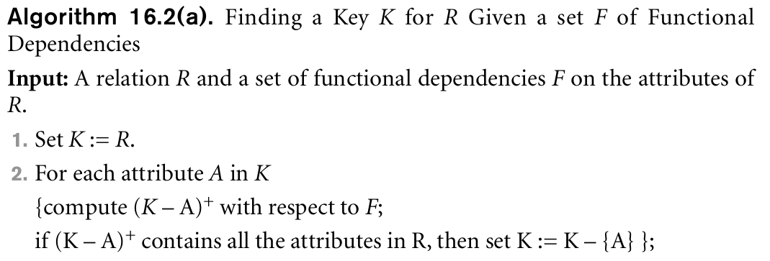
Algorithm to determine the key of a relation
In Algorithm 16.2(a), we start by setting K to all the attributes of R; we then remove one attribute at a time and check whether the remaining attributes still form a superkey.
Notice, that Algorithm 16.2(a) determines only one key out of the possible candidate keys for R; the key returned depends on the order in which attributes are removed from R in step 2
Slide 10- <number>

Slide 26
3 Normal Forms Based on Primary Keys
Normalization of Relations
Practical Use of Normal Forms
Definitions of Keys and Attributes Participating in Keys
First Normal Form
Second Normal Form
Third Normal Form
Slide 10- <number>

Slide 27
3.1 Normalization of Relations (1)
Normalization:
  The process of decomposing unsatisfactory "bad" relations by breaking up their attributes into smaller relations
Normalization of data
  can be considered a process of analyzing the given relation schemas based on their FDs and primary keys to achieve the desirable properties of (1) minimizing redundancy and (2) minimizing the insertion, deletion, and update anomalies
Normal form:
  Condition using keys and FDs of a relation to certify whether a relation schema is in a particular normal form
Slide 10- <number>

Slide 28
Thus, the normalization procedure provides database designers with the following:
  A formal framework for analyzing relation schemas based on their keys and on the functional dependencies among their attributes
  A series of normal form tests that can be carried out on individual relation schemas so that the relational database can be normalized to any desired degree
Definition. The normal form of a relation refers to the highest normal form condition that it meets, and hence indicates the degree to which it has been normalized.
Slide 10- <number>

Slide 29
Normalization of Relations (2)
2NF, 3NF, BCNF
  based on keys and FDs of a relation schema
4NF
  based on keys, multi-valued dependencies : MVDs; 5NF based on keys, join dependencies : JDs (Chapter 11)
Additional properties may be needed to ensure a good relational design (lossless join, dependency preservation; Chapter 11)
Slide 10- <number>

Slide 30
3.2 Practical Use of Normal Forms
Normalization is carried out in practice so that the resulting designs are of high quality and meet the desirable properties
The practical utility of these normal forms becomes questionable when the constraints on which they are based are hard to understand or to detect
The database designers need not normalize to the highest possible normal form
  (usually up to 3NF, BCNF or 4NF)
Denormalization:
  The process of storing the join of higher normal form relations as a base relation—which is in a lower normal form
Slide 10- <number>

Slide 31
3.3 Definitions of Keys and Attributes Participating in Keys (1)
A superkey of a relation schema R = {A1, A2, ...., An} is a set of attributes S subset-of R with the property that no two tuples t1 and t2 in any legal relation state r of R will have t1[S] = t2[S]
A key K is a superkey with the additional property that removal of any attribute from K will cause K not to be a superkey any more.
Eg:{Ssn} is a key for EMPLOYEE, whereas {Ssn}, {Ssn, Ename}, {Ssn, Ename, Bdate}, and any set of attributes that includes Ssn are all superkeys.
Slide 10- <number>

Slide 32
Definitions of Keys and Attributes Participating in Keys (2)
If a relation schema has more than one key, each is called a candidate key.
  One of the candidate keys is arbitrarily designated to be the primary key, and the others are called secondary keys.
  {Ssn} is the only candidate key for EMPLOYEE,so it is also the primary key.
A Prime attribute must be a member of some candidate key
A Nonprime attribute is not a prime attribute—that is, it is not a member of any candidate key.
both Ssn and Pnumber are prime attributes of WORKS_ON, whereas other attributes of WORKS_ON are nonprime.
Slide 10- <number>

Slide 33
3.2 First Normal Form
Disallows
  composite attributes
  multivalued attributes
  nested relations; attributes whose values for an individual tuple are non-atomic
Considered to be part of the definition of relation
The only attribute values permitted by 1NF are single atomic (or indivisible) values.
Slide 10- <number>

Slide 34

Normalization into 1NF
Solution 1
Slide 10- <number>

Slide 35
Solution 2
If a maximum number of values is known for the attribute—for example, if it is known that at most three locations can exist for a department—replace the Dlocations attribute by three atomic attributes: Dlocation1, Dlocation2, and Dlocation3.
This solution has the disadvantage of introducing NULL values if most departments have fewer than three locations.
It further introduces spurious semantics about the ordering among the location values that is not originally intended.
Slide 10- <number>

Slide 36
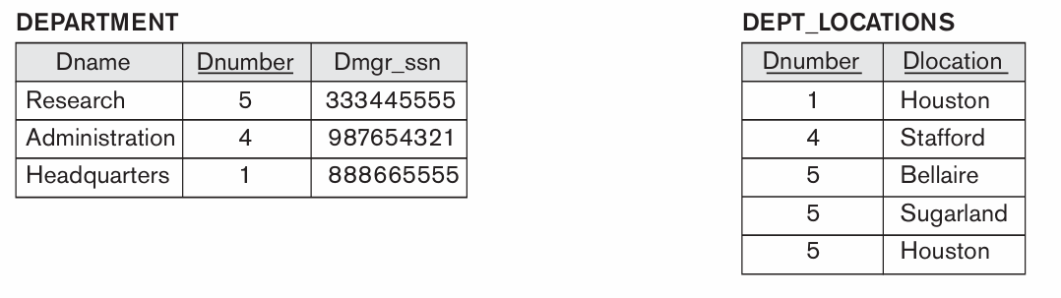
Solution 3 which is preferred
Remove the attribute Dlocations that violates 1NF and place it in a separate relation DEPT_LOCATIONS along with the primary key Dnumber of DEPARTMENT. The primary key of this relation is the combination {Dnumber, Dlocation}.
A distinct tuple in DEPT_LOCATIONS exists for each location of a department.
This decomposes the non-1NF relation into two 1NF relations
Slide 10- <number>

Slide 37
The EMP_PROJ relation could appear if nesting is allowed, then the schema of this EMP_PROJ relation can be represented as follows:
EMP_PROJ(Ssn, Ename,{PROJS(Pnumber, Hours)})
where the attribute PROJS is multivalued.
Decomposition and primary key propagation yield the schemas EMP_PROJ1 and EMP_PROJ2
Slide 10- <number>

Slide 38
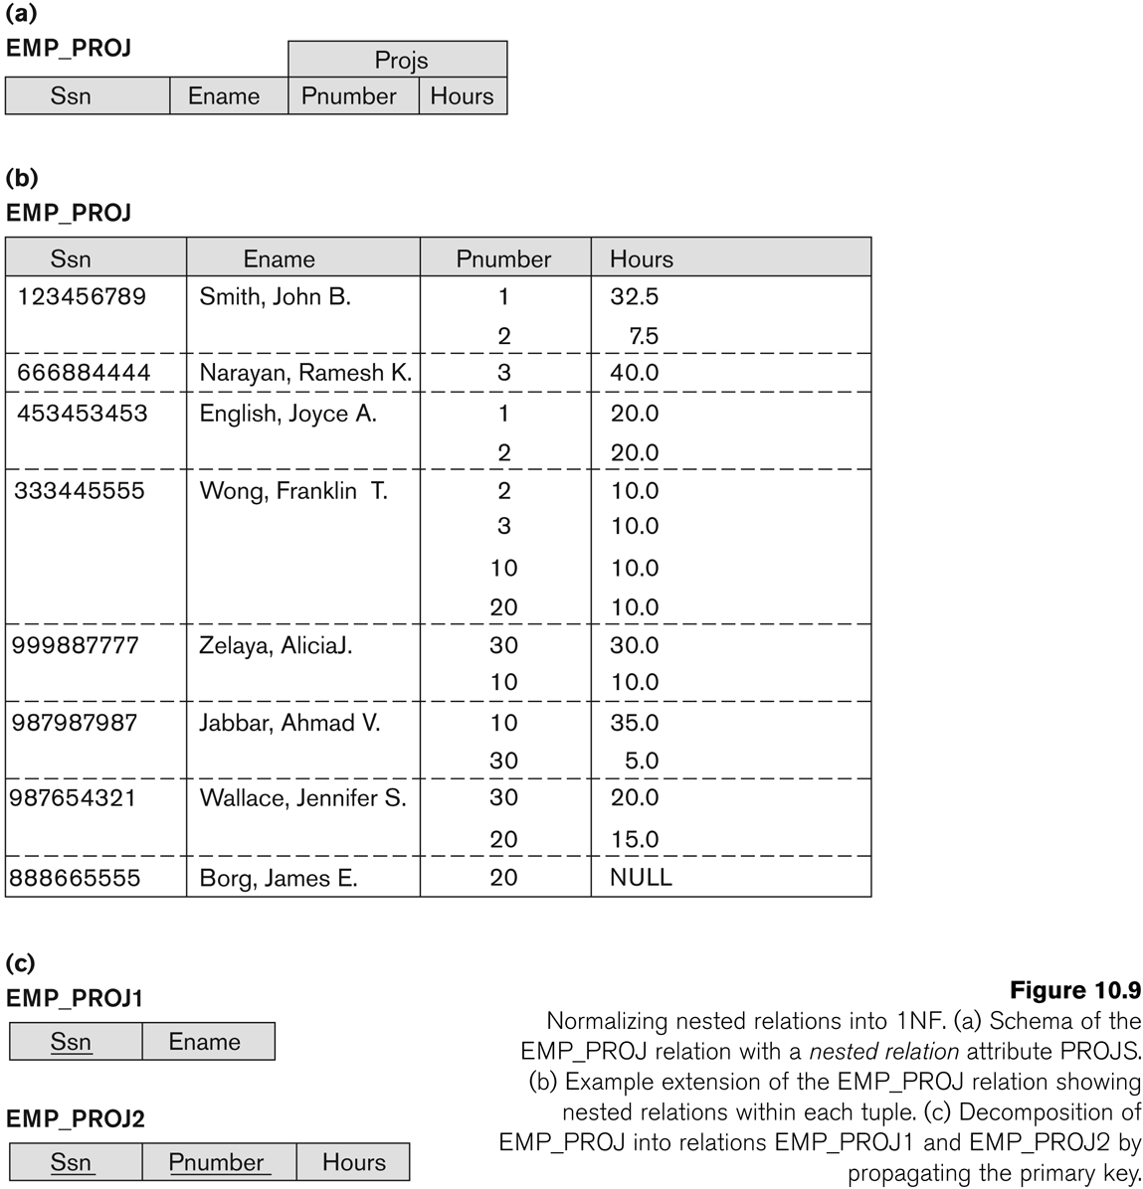
Normalization nested relations into 1NF
Slide 10- <number>

Slide 39
3.3 Second Normal Form (1)
Uses the concepts of FDs, primary key
Definitions
  Prime attribute: An attribute that is member of the primary key K
  Full functional dependency: a FD Y -> Z where removal of any attribute from Y means the FD does not hold any more
Examples:
  {SSN, PNUMBER} -> HOURS is a full FD since neither SSN -> HOURS nor PNUMBER -> HOURS hold
  {SSN, PNUMBER} -> ENAME is not a full FD (it is called a partial dependency ) since SSN -> ENAME also holds
Slide 10- <number>

Slide 40
Second Normal Form (2)
Definition: A relation schema R is in second normal form (2NF) if every non-prime attribute A in R is fully functionally dependent on the primary key
R can be decomposed into 2NF relations via the process of 2NF normalization
Find out the FD is in the following relation
Slide 10- <number>

Slide 41
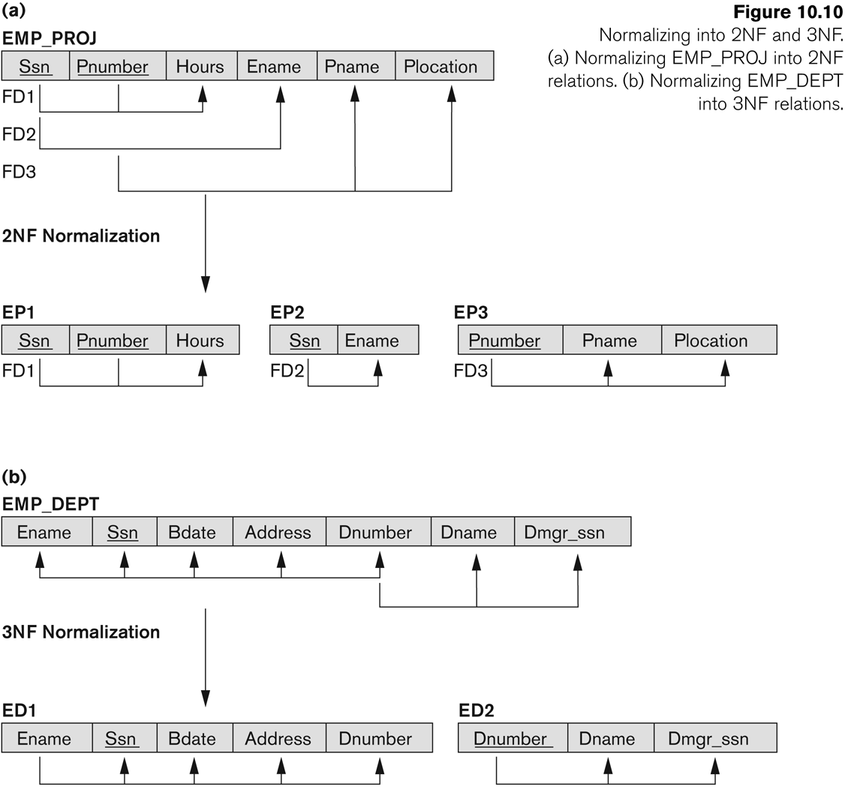
Normalizing into 2NF and 3NF
Slide 10- <number>

Slide 42
3.4 Third Normal Form (1)
Definition:
  Transitive functional dependency: a FD X -> Z that can be derived from two FDs X -> Y and Y -> Z
  Y should not be non prime attribute when deriving transitive attribute
Examples:
  SSN -> DMGRSSN is a transitive FD
    Since SSN -> DNUMBER and DNUMBER -> DMGRSSN hold
    DNUMBER is non prime attribute in EMPLOYEE table
  SSN -> ENAME is non-transitive
    Since there is no set of attributes X where SSN -> X and X -> ENAME
Slide 10- <number>

Slide 43
Third Normal Form (2)
A relation schema R is in third normal form (3NF) if it is in 2NF and no non-prime attribute A in R is transitively dependent on the primary key
R can be decomposed into 3NF relations via the process of 3NF normalization
NOTE:
  In X -> Y and Y -> Z, with X as the primary key, we consider this a problem only if Y is not a candidate key.
  When Y is a candidate key, there is no problem with the transitive dependency .
  E.g., Consider EMP (SSN, Emp#, Salary ).
    Here, SSN -> Emp# -> Salary and Emp# is a candidate key.
Slide 10- <number>

Slide 44
Consider the relation schema LOTS, which describes parcels of land for sale in various counties of a state.
Suppose that there are two candidate keys: Property_id# and {County_name, Lot#}; that is, lot numbers are unique only within each county, but Property_id# numbers are unique across counties for the entire state.
Find out the FDs in the following relation LOTS
Slide 10- <number>

Slide 45
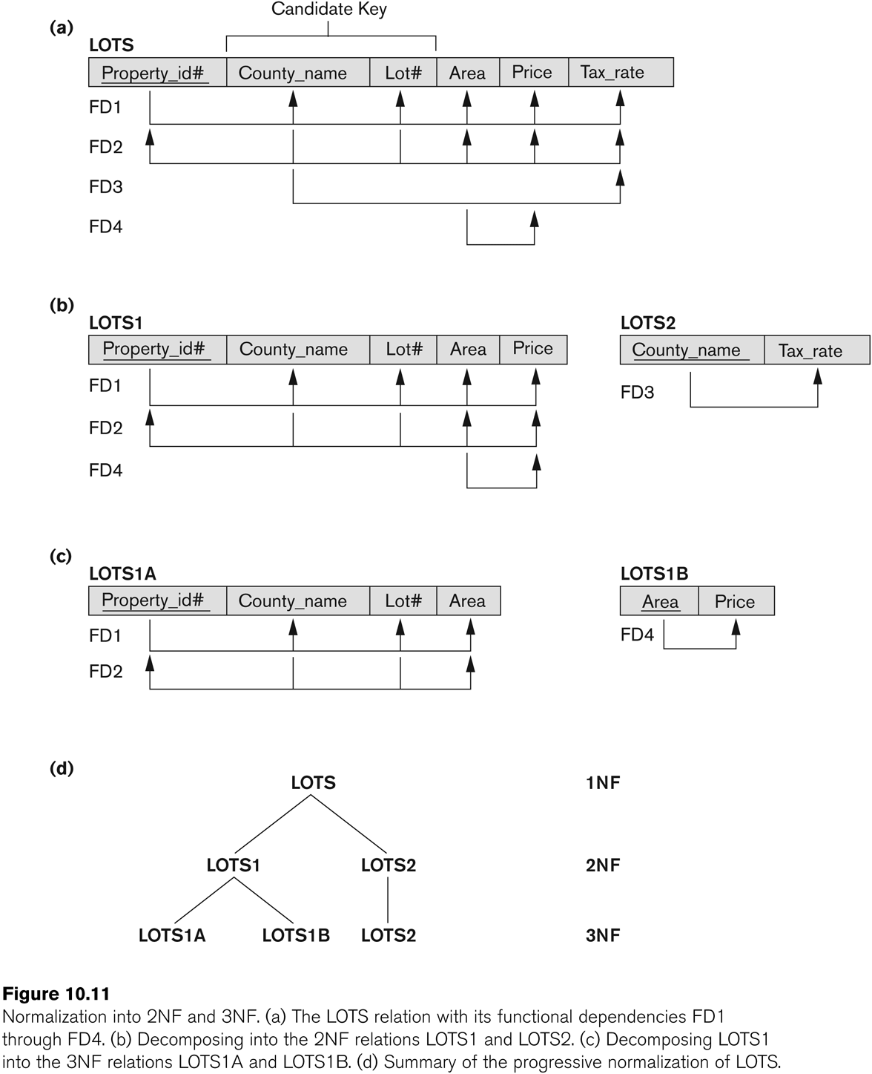
Normalization into 2NF and 3NF
Slide 10- <number>

Slide 46
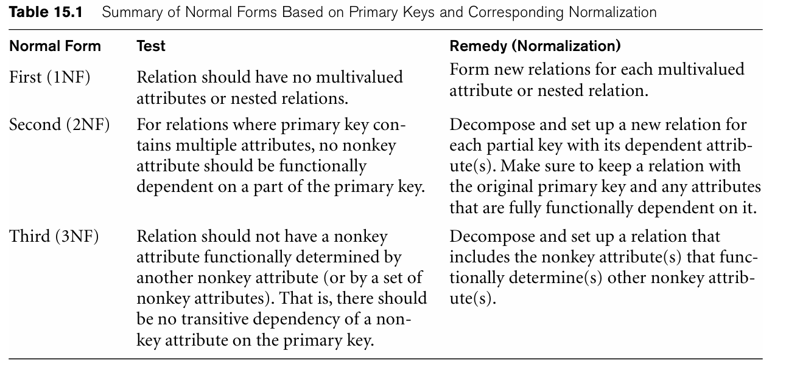
Slide 10- <number>

Slide 47
Normal Forms Defined Informally
1st normal form
  All attributes depend on the key
2nd normal form
  All attributes depend on the whole key
3rd normal form
  All attributes depend on nothing but the key
Slide 10- <number>

Slide 48
4 General Normal Form Definitions (For Multiple Keys) (1)
Design our relation schemas so that they have neither partial nor transitive dependencies because these types of dependencies cause the update anomalies
The above definitions consider the primary key only
As a general definition of prime attribute, an attribute that is part of any candidate key will be considered as prime.
Partial and full functional dependencies and transitive dependencies will now be considered with respect to all candidate keys of a relation.
Slide 10- <number>

Slide 49
General Definition of Second Normal Form
Definition: A relation schema R is in second normal form (2NF) if every non prime attribute A in R is not partially dependent on any key of R.
The test for 2NF involves testing for functional dependencies whose left-hand side attributes are part of the primary key.
Suppose if we introduce the below dependencies to LOTS relations
  FD3: County_name → Tax_rate
  FD4: Area → Price
Slide 10- <number>

Slide 50
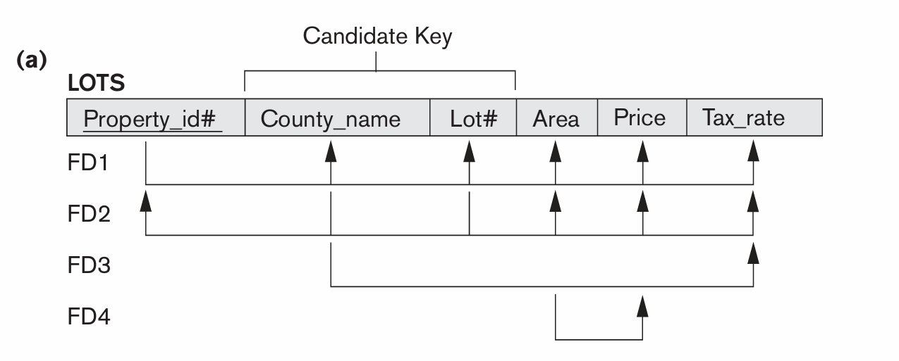
The LOTS relation schema violates the general definition of 2NF because Tax_rate is partially dependent on the candidate key {County_name, Lot#}, due to FD3.
Slide 10- <number>

Slide 51
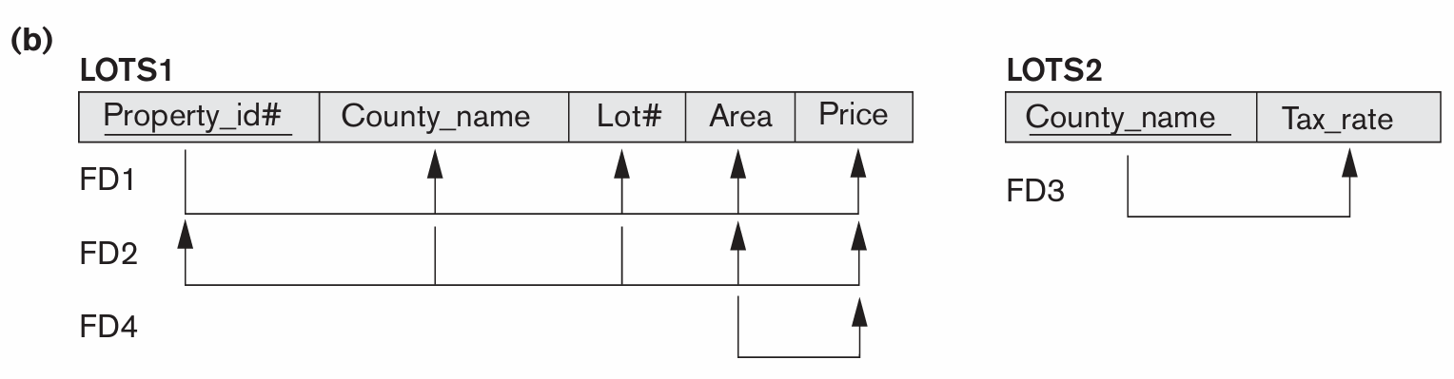
Normalizing into 2NF
To normalize LOTS into 2NF, we decompose it into the two relations LOTS1 and LOTS2
Notice that FD4 does not violate 2NF and is carried over to LOTS1
Slide 10- <number>

Slide 52
General Normal Form Definitions (2)
Definition:
  Superkey of relation schema R - a set of attributes S of R that contains a key of R
  A relation schema R is in third normal form (3NF) if whenever a nontrivial FD X -> A holds in R, then either:
    (a) X is a superkey of R, or
    (b) A is a prime attribute of R
NOTE: Boyce-Codd normal form disallows condition (b) above
Slide 10- <number>

Slide 53
According to this definition, LOTS2 is in 3NF
Slide 10- <number>

Slide 54
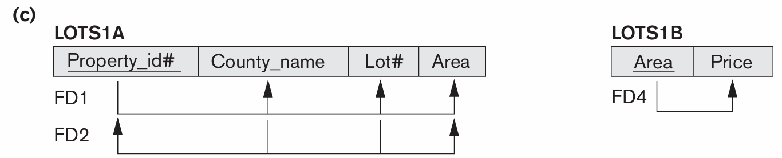
However, FD4 in LOTS1 violates 3NF because Area is not a superkey and Price is not a prime attribute in LOTS1.
To normalize LOTS1 into 3NF, we decompose it into the relation schemas LOTS1A and LOTS1B
Slide 10- <number>

Slide 55
5 BCNF (Boyce-Codd Normal Form)
A relation schema R is in Boyce-Codd Normal Form (BCNF) if whenever an FD X -> A holds in R, then X is a superkey ofR
Each normal form is strictly stronger than the previous one
  Every 2NF relation is in 1NF
  Every 3NF relation is in 2NF
  Every BCNF relation is in 3NF
There exist relations that are in 3NF but not in BCNF
The goal is to have each relation in BCNF (or 3NF)
The formal definition of BCNF differs from the definition of3NF in that condition (b) of3NF,which allows Ato be prime, is absent from BCNF.
That makes BCNF a stronger normal form compared to 3NF.
Slide 10- <number>

Slide 56
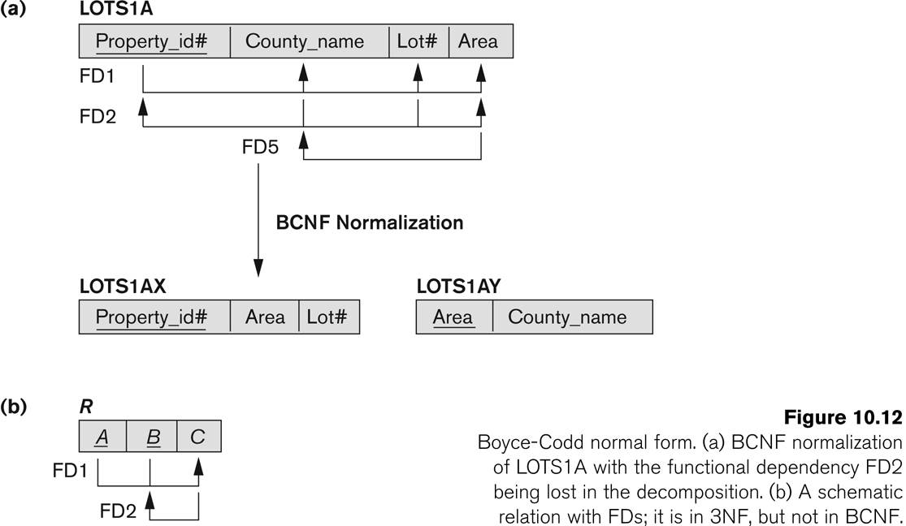
Boyce-Codd normal form
Slide 10- <number>

Slide 57
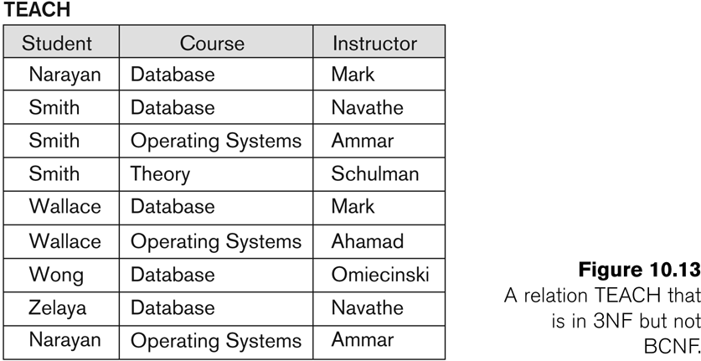
Consider the relation TEACH that is in 3NF but not in BCNF
relation TEACH with the following dependencies: FD1: {Student,Course}→Instructor
FD2: Instructor→Course
Slide 10- <number>

Slide 58
Achieving the BCNF by Decomposition (1)
Two FDs exist in the relation TEACH:
  fd1: { student, course} -> instructor
  fd2: instructor -> course
{student, course} is a candidate key for this relation and that the dependencies shown follow the pattern in Figure 15.13 (b).
  So this relation is in 3NF but not in BCNF
A relation NOT in BCNF should be decomposed so as to meet this property, while possibly forgoing the preservation of all functional dependencies in the decomposed relations.
Slide 10- <number>

Slide 59
Achieving the BCNF by Decomposition (2)
Three possible decompositions for relation TEACH
  {student, instructor} and {student, course}
  {course, instructor } and {course, student}
  {instructor, course } and {instructor, student}
All three decompositions will lose FD1.
  We have to settle for sacrificing the functional dependency preservation. But we cannot sacrifice the non-additivity property after decomposition.
Out of the above three, only the 3rd decomposition will not generate spurious tuples after join
Slide 10- <number>

Slide 60
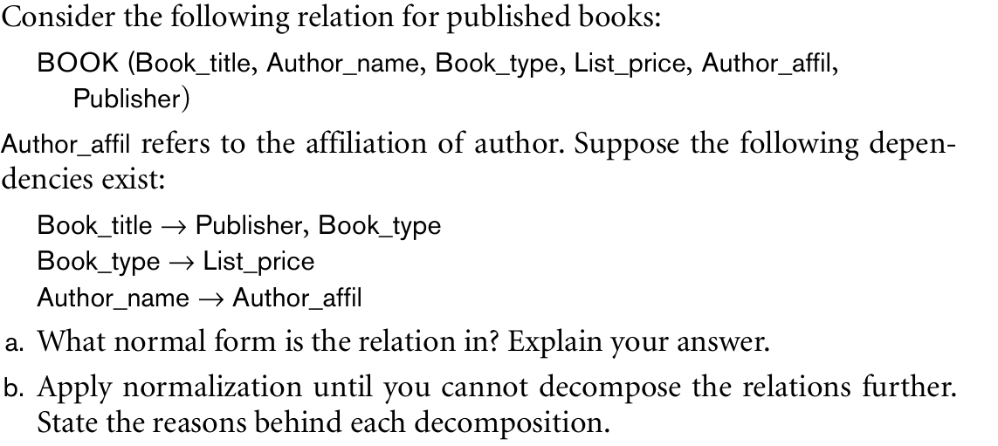
Slide 10- <number>

Slide 61
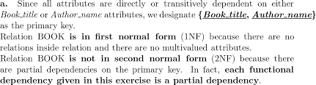
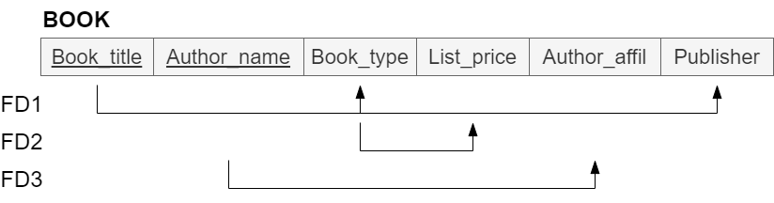
Slide 10- <number>

Slide 62
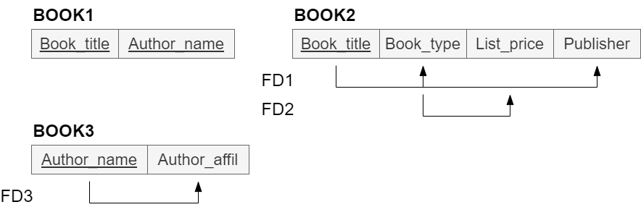
Decomposing it into 2NF
Slide 10- <number>

Slide 63
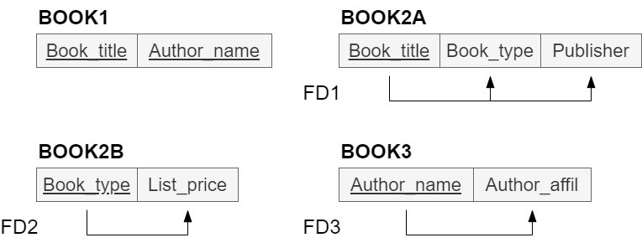
Decomposing it into 3NF
Slide 10- <number>

Slide 64
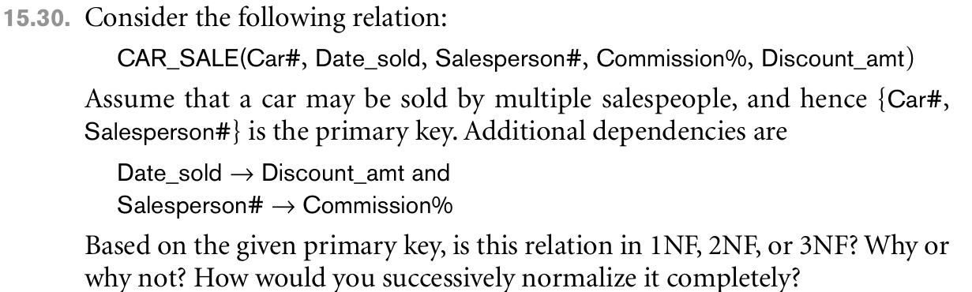
Slide 10- <number>

Slide 65
Firstly we notice that there is a single candidate key {Car#, Salesperson#} so we can use definitions of normal forms based on the primary key.
In order for relation CAR SALE to be in second normal form we need to decompose it into two relations CAR_SALE1 and CAR_SALE2.
This will eliminate partial dependencies on primary key.
The primary key of relation CAR_SALE1 is {Car#, Salesperson#} and of CAR SALE2 is Salesperson#.
Slide 10- <number>

Slide 66
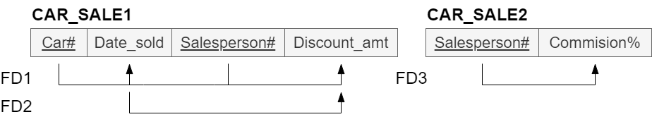
Slide 10- <number>

Slide 67
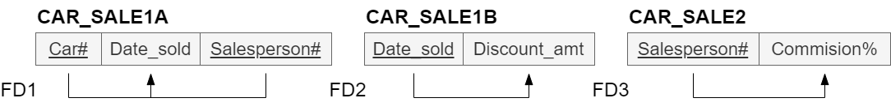
Slide 10- <number>

Slide 68
Properties of Relational Decompositions
Relation Decomposition and Insufficiency of Normal Forms
The relational database design algorithms that we have seen so far has a universal relation schema R = {A1, A2, ..., An} that includes all the attributes of the database.
We implicitly make the universal relation assumption, which states that every attribute name is unique.
Using the functional dependencies, the algorithms decompose the universal relation schema R into a set of relation schemas D = {R1, R2, ..., Rm} that will become the relational database schema; D is called a decomposition of R.
Slide 10- <number>

Slide 69
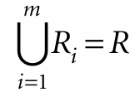
We must make sure that each attribute in R will appear in at least one relation schema Ri in the decomposition so that no attributes are lost; formally, we have
This is called the attribute preservation condition of a decomposition.
Another goal is to have each individual relation Ri in the decomposition D be in BCNF or 3NF.
Slide 10- <number>

Slide 70
When relation is in BCNF and joined with a relation not in BCNF gives rise to spurious tuples
To avoid this, we have additional conditions that should hold on a decomposition D are:
  Dependency Preservation Property of a Decomposition
  Nonadditive (Lossless) Join Property of a Decomposition
  Testing Binary Decompositions for the Nonadditive Join Property
  Successive Nonadditive Join Decompositions
Slide 10- <number>

Slide 71
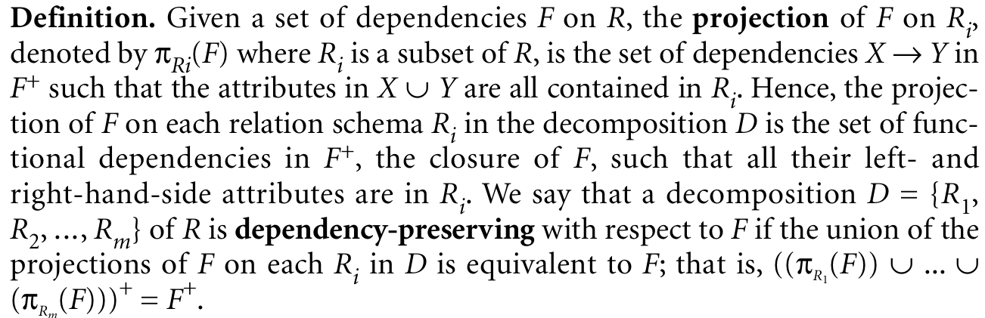
1. Dependency Preservation Property of a Decomposition
It would be useful if each functional dependency X→Y specified in F either appeared directly in one of the relation schemas Ri in the decomposition D or could be inferred from the dependencies that appear in some Ri .
Informally, this is the dependency preservation condition.
Slide 10- <number>

Slide 72
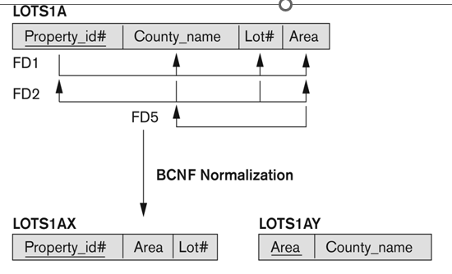
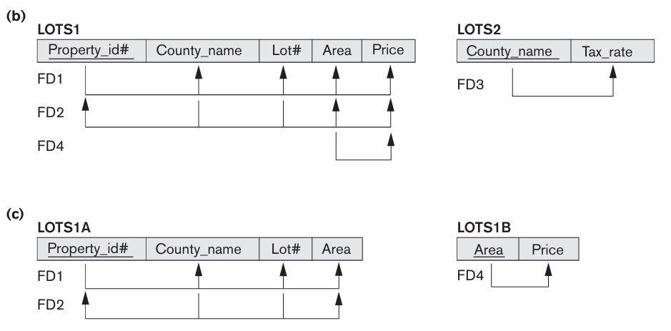
For eg FD 2 is lost when LOTS is decomposed into {LOTS1AX, LOTS1AY} during the normalization process in previous slides
But in the following
it is preserved
Slide 10- <number>

Slide 73
Claim 1. It is always possible to find a dependency-preserving decomposition D with respect to F such that each relation Ri in D is in 3NF.
Slide 10- <number>

Slide 74
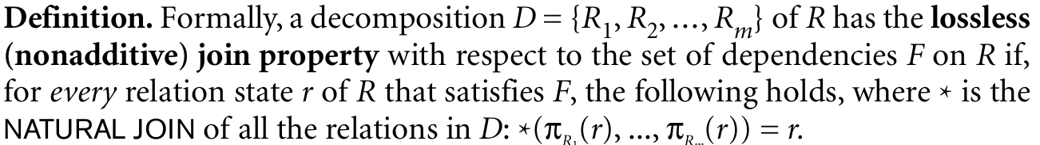
2. Nonadditive (Lossless) Join Property of a Decomposition
Another property that a decomposition D should possess is the nonadditive join property, which ensures that no spurious tuples are generated when a NATURAL JOIN operation is applied to the relations resulting from the decomposition.
Slide 10- <number>

Slide 75
If a decomposition does not have the lossless join property, we may get additional spurious tuples after the PROJECT (π) and NATURAL JOIN (*) operations are applied; these additional tuples represent erroneous or invalid information.
Following is the algorithm for testing this property
Slide 10- <number>

Slide 76
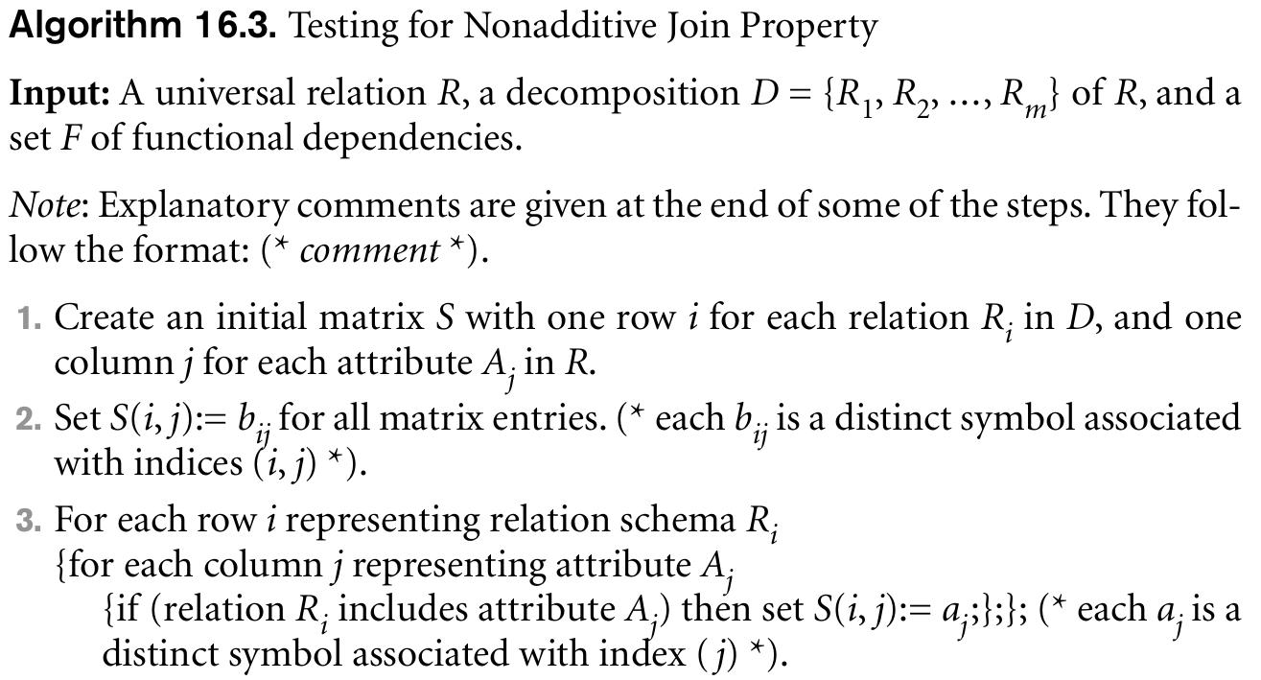
Slide 10- <number>

Slide 77
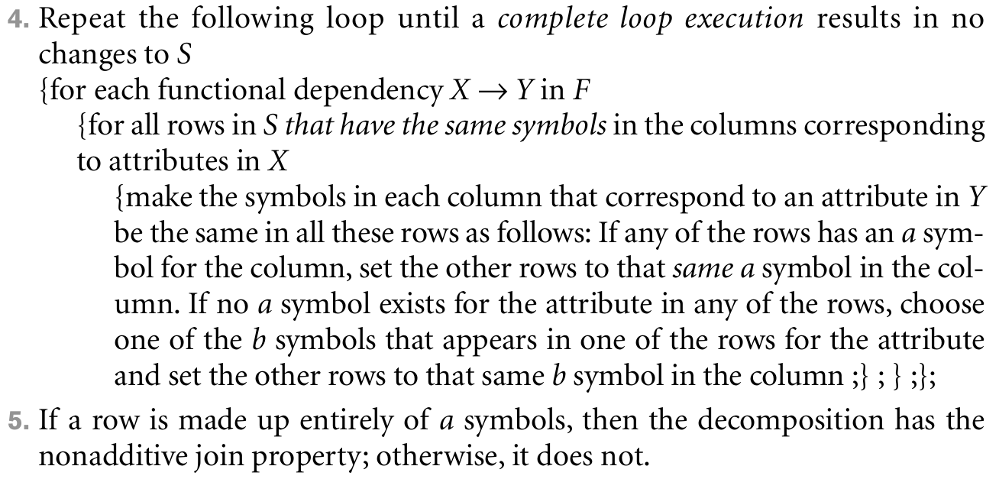
Slide 10- <number>

Slide 78
Consider an example R = {A,B,C,D,E} is decomposed into R1(ABCD) and R2(DE)
If F= {A->B, A->C, A->D,D->E}. Find whether it is Lossy or Lossless
Step 1: Create the matrix S according to the algorithm
Since R1 row has all a’s, the decomposition is lossless.
 | A | B | C | D | E
R1 | a1 | a2 | a3 | a4 | b15 a5
R2 | b21 | b22 | b23 | a4 | a5
Slide 10- <number>

Slide 79
Consider R = {A,B,C,D} and decompositions R1(AD), R2(AB), R3(BE),R4(CDE),R5(AE). For the FDs
F = {A->C, B->C, C->D,DE->C,CE->A} , using the algorithm find out the decomposition is lossy or lossless.
Slide 10- <number>

Slide 80
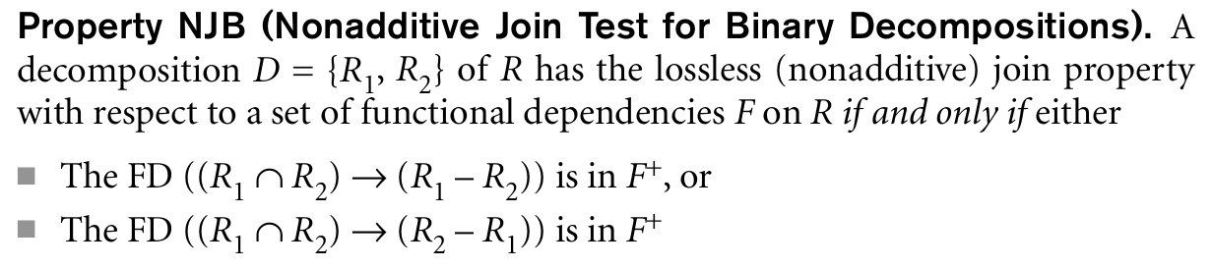
3. Testing Binary Decompositions for the Nonadditive Join Property
There is a special case of a decomposition called a binary decomposition—decomposition of a relation R into two relations.
Slide 10- <number>

Slide 81

Eg: R1(ABCD) and R2(DE) and F= {A->B, A->C, A->D,D->E}.
R1 R2 -> R2-R1 that is D->E is in F+ hence the decomposition is lossless
Slide 10- <number>

Slide 82
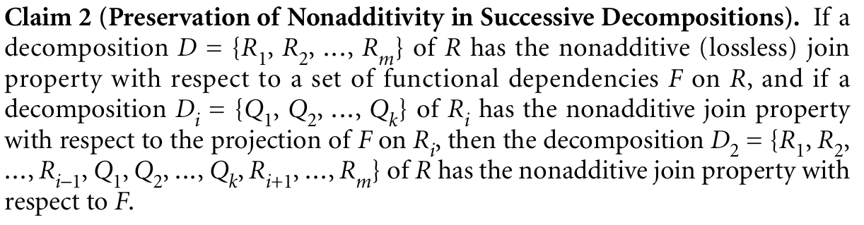
4. Successive Nonadditive Join Decompositions
We saw the successive decomposition of relations during the process of second and third normalization in previous slides.
To verify that these decompositions are nonadditive, we need to ensure another property, as set forth in Claim 2.
Slide 10- <number>

